Slide 1
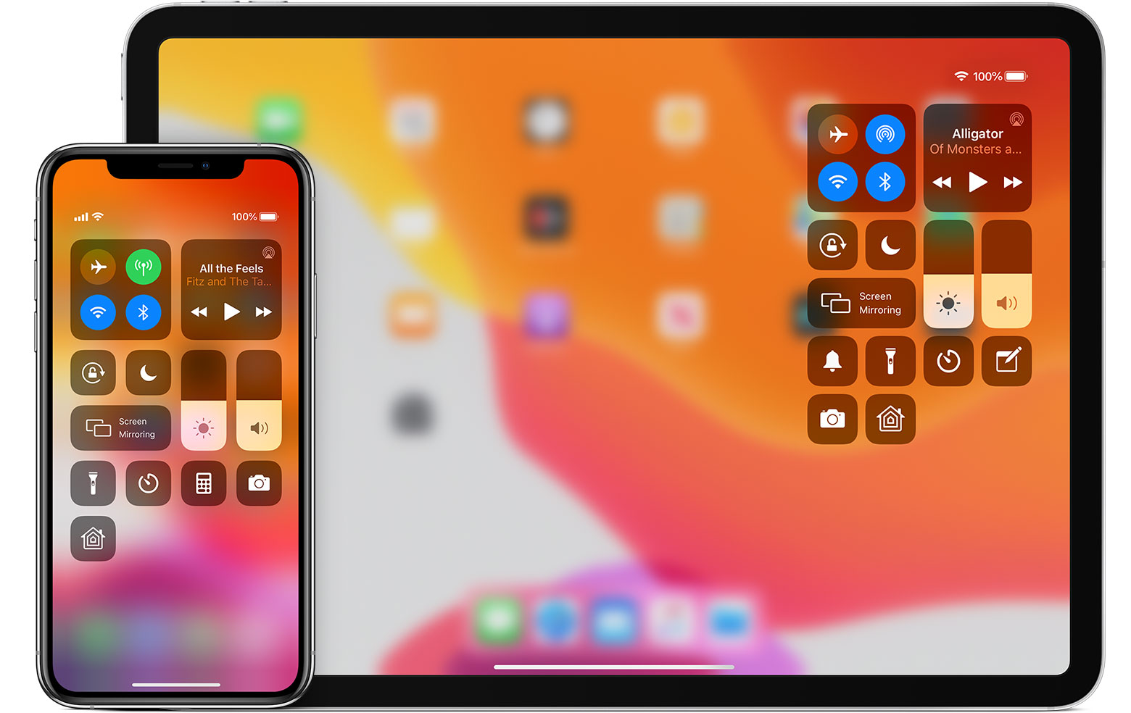







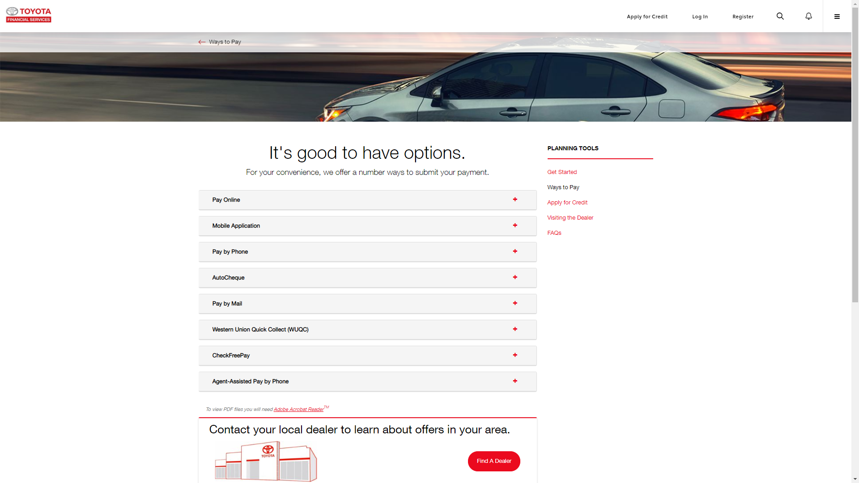

A Provider of Mobility Services
We are transforming to a Mobility Service Provider for internal and external customers, following a Software as a Platform (SaaP) model.
‘mFin’ Platform
One Toyota/Lexus App with F&I
F& I Core Business Systems
Financial
Platform products are delivered to the customers as consumable services
Platform services provide their functionality via published APIs
Financial
Other Brand Apps with F&I
SFC
mFin Data Lake and mFin Document Lake
API Store and Micro Services
‘mFin’ Platform Built and Operated in Cloud
SFC
Identity & Access Management
…
…
Multi Device Experience Layer
External Partner /
Affiliate Systems
Browser Portals/Sites with F&I
Notes:
If we need to build an F&I app for a brand we will use the red layer / experience platform. If we need to place F&I capabilities on apps like OneApp we will use our API store to integrate with out core systems.
This architecture that we call ‘mFin’ allows us to build a customer chosen experience. Allows us to build F&I capabilities ones and place them on various apps and sites. We believe that it is our customers choice and we will be where our customers are…. OneApp, Smartpath, TFS.com or Kinto…

Slide 2

API as a Product
Mobility Service Platform provides a set of core services that can be easily evolved and reconfigured in response to changing business needs.
We are designing the APIs based on the API as a Product principles:
Treat API as product and act like a product owner,
Actively improve and maintain API consistency over the long term,
Make use of customers’ feedbacks and provide service level support.
Embracing API as a Product facilitates a service ecosystem which can be evolved more easily, and used to experiment quickly with new business ideas by recombining core capabilities.

Slide 3
Our API Development Approach
Designing and developing of high-quality, long-lasting APIs is critical for successful deployment of SaaP and for TFS’ digital transformation to a Mobility Service Provider.
Our API software architecture centers around decoupled microservices that provide functionality via RESTful APIs with a JSON payload.
We design APIs to express what our systems do, and are therefore highly valuable business assets. (example DDC …)
Small engineering teams own, deploy and operate these microservices (example ESP team …)
We promote use of software design patterns and standards to increase API quality and reduce development time - increase velocity (example Architectural Decisions in git, …)
We use DevOps approach to agile software development based on Vogels’ principle:
“You Build It, You Run It.”
Agile
Teams
Use of
Standards
Microservices
DevOps
Software as a Platform

Slide 4
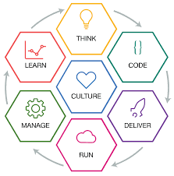
DevOps
Our teams practice the TFS Factory Production model.
We are also inspired by Vogels’ DevOps agile software development principle: “You Build It, You Run It.”
End-to-end Ownership
Team owns service from design to development to retirement
Team is responsible for:
Features
Quality
Performance
Operations
Maintenance

Slide 5
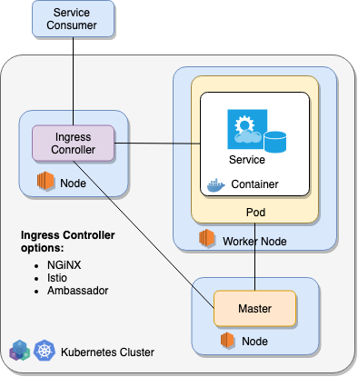
What are Patterns?
A pattern is a general, reusable solution to a commonly occurring problem, it is a description or template for how to solve a problem that can be used in many different situations.

Slide 6
What are Patterns?
A pattern is a general, reusable solution to a commonly occurring problem, it is a description or template for how to solve a problem that can be used in many different situations.
Microservice Patterns:
Persistence Pattern
Aggregate Pattern
Shared Data Pattern
Saga Pattern

Slide 7
What are Patterns?
A pattern is a general, reusable solution to a commonly occurring problem, it is a description or template for how to solve a problem that can be used in many different situations.
Microservice Patterns:
Persistence Pattern
Aggregate Pattern
Shared Data Pattern
Saga Pattern
Deployment Patterns:
Single Tenant Cluster
Shared Control Plane
Namespace per Tenant

Slide 8
What are Patterns?
A pattern is a general, reusable solution to a commonly occurring problem, it is a description or template for how to solve a problem that can be used in many different situations.
Service Routing Patterns:
Single Ingress Pattern
Ingress per Tenant Pattern
Microservice Patterns:
Persistence Pattern
Aggregate Pattern
Shared Data Pattern
Saga Pattern
Deployment Patterns:
Single Tenant Cluster
Shared Control Plane
Namespace per Tenant

Slide 9
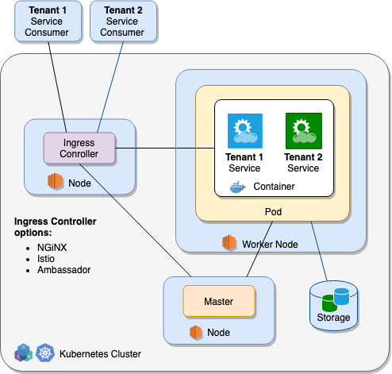
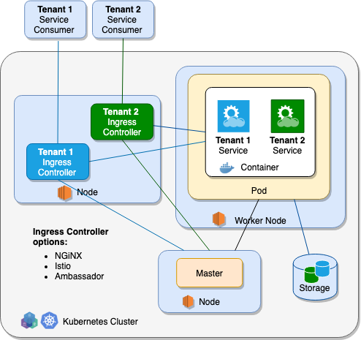
mFin Service Routing Patterns
Tenants
Authenticated tenants’ users are routed to appropriate services based on Tenant IDs or they accessing a tenant specific end-points.
Single Ingress
Pattern
Ingress per Tenant
Pattern
Shared End-Points – routing based on Tenant ID
Tenant Specific End-Points

Slide 10
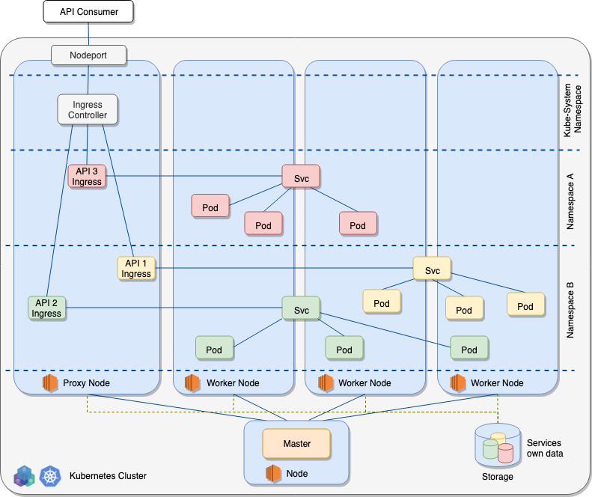
Microservices – Deployment Pattern
We build microservices using containers and deploy them into Kubernetes clusters.
A Kubernetes platform consists of a cluster of nodes that provide core functionality:
Worker Nodes provide run-time environments for Pods and Containers,
Master Nodes manage and control Worker Nodes,
Proxy Nodes transmits external request (HTTP requests via Ingress Controller and TCP requests via Nodeports) to Services created inside the cluster,
Containers come and go without keeping any state. To keep state across container restarts, Kubernetes offers storage services.
A Service is a Kubernetes component which wraps one or more similar Pods and exposes a given functionality (Service) to outside world.
A Deployment is a configuration which can create a given set of Kubernetes artefacts like pods, services, replica sets, etc.
Namespaces are virtual clusters used to categorize different components which are related within Kubernetes.

Slide 11
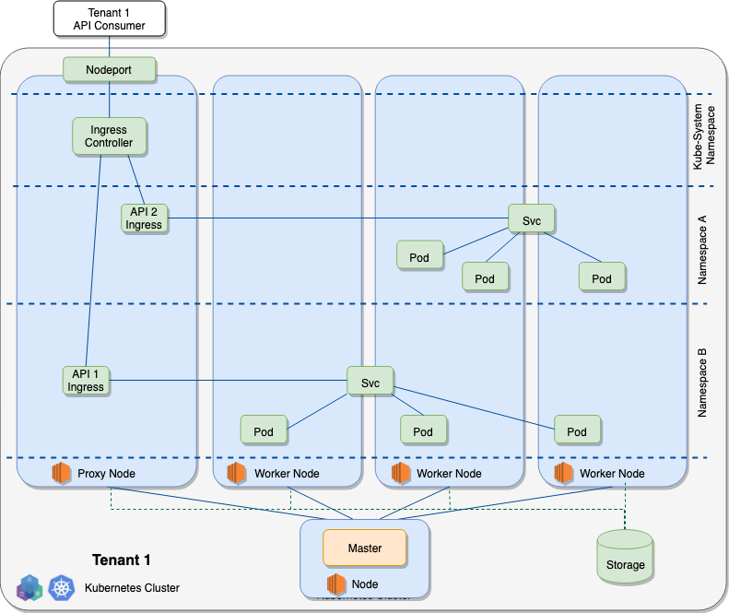
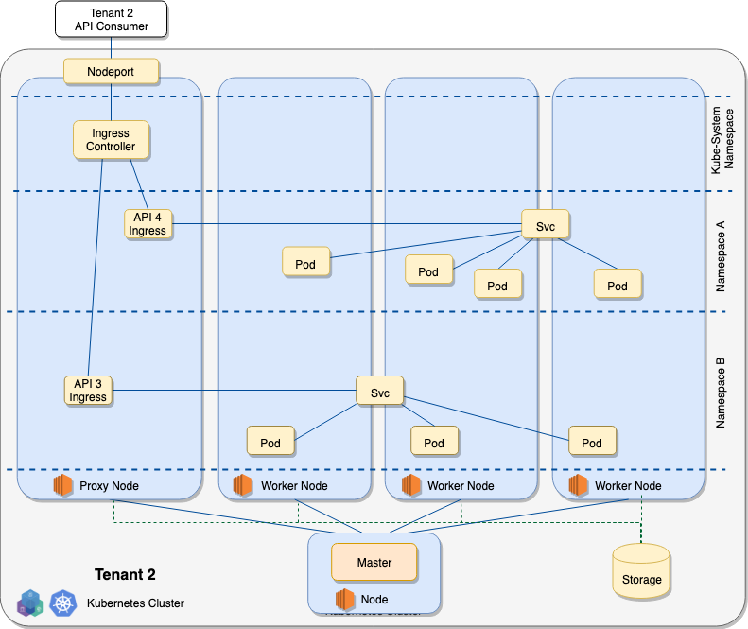
mFin Deployment Pattern – Single Tenant Cluster
Tenants
In this pattern (Hard Multitenancy) there is a zero trust between tenants. Tenants should not have access to anything from other tenants.

Slide 12
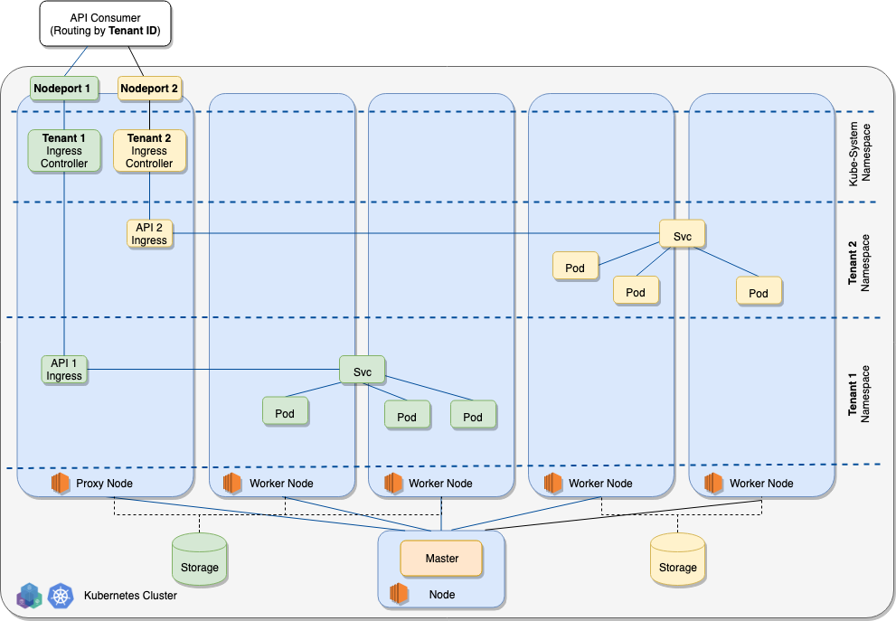
mFin Deployment Pattern – Shared Control Plane
Tenants
This is another Hard Multitenancy pattern where tenants should not have access to anything from other tenants, except for the Kubernetes’ APIs.
Tenants share access to Kubernetes’ APIs,
Access to the APIs is protected based on Tenant ID,
Each tenant can access the APIs - using their Tenant ID - to run their own controllers/operators and take other actions on objects within their namespaces,
Authenticated tenants’ users are routed to appropriate services based on Tenant IDs or they accessing a tenant specific end-points.

Slide 13
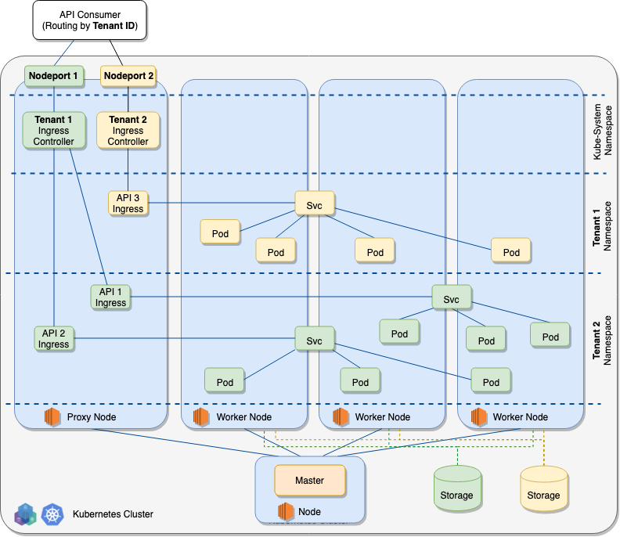
mFin Deployment Pattern – Namespace per Tenant
Tenants
In this pattern (Soft Multitenancy) all tenants share the same pool of Worker Nodes, however, each tenant is given its own Namespace.
In this deployment pattern single Master controls a large cluster.
The cluster administrator has ”root” admin rights in order to:
Operate the cluster,
Set up namespaces,
Set up resource limits.
Namespace administrators have admin right access only to their specific namespaces.
Authenticated tenants’ users are routed to appropriate services based on Tenant IDs or they accessing a tenant specific end-points.

Slide 14
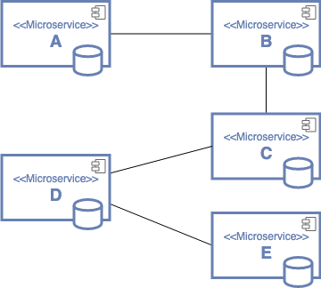
Microservices
Our API software architecture centers around decoupled independent services modeled around business domains – each service has a business boundary which can be independently developed, tested, deployed, monitored, and scaled.
Our services are characterized by:
Single-purpose
Simple, well defined interface
Modular and independent
Isolated persistence

Slide 15
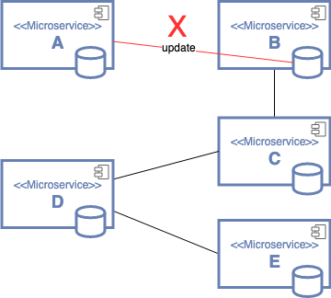
Microservice – Persistence Patterns
Principle: External access to data store is only through published service interface.
Approach 1: Service operates its own data store (Consumer Lease, Consumer Loan, …)
Approach 2: Use of a persistence service (Change Log Service, …)
Antipattern: Service A directly updates data owned by Service B

Slide 16
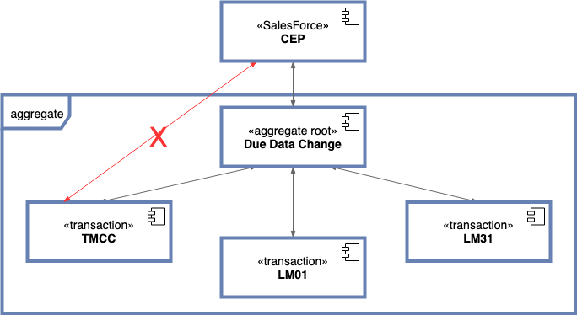
Microservices - Aggregate Pattern
We use an Aggregate Pattern to implement a cluster of domain objects that need to be transnationally consistent.
An aggregate is composed of at least one entity: the aggregate root.
Additionally, it can have multiple child entities and value objects.
The purpose of an aggregate root is to ensure the consistency of the aggregate; it should be the only entry point for updates to the aggregate.
The Lemans Due Date Change is accomplished as series of Mainframe requests that need to be transnationally consistent.

Slide 17
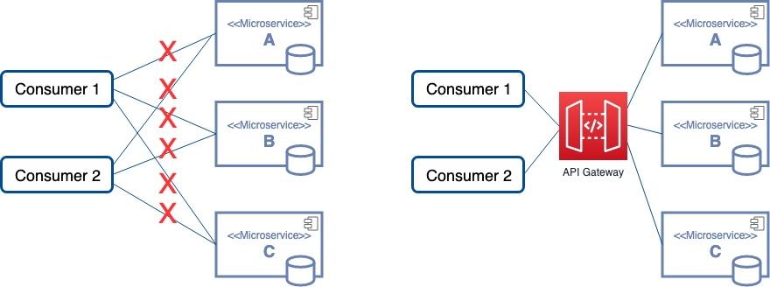
Microservice – API Gateway Pattern
We implemented API gateway that is the single entry point for all consumers to access our services.
Antipattern
Pattern

Slide 18
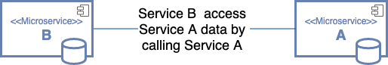
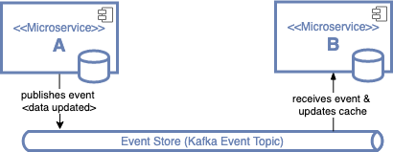
Microservices – Shared Data Patterns
Sharing data between microservices is supported via synchronous lookup pattern or via asynchronous event based pattern.
Synchronous lookup. (User Access Provisioning, …)
Asynchronous event + local cache (Signal project, …)
Shared metadata library – basically immutable (Branch State List, … )
Event & Data might be separated

Slide 19
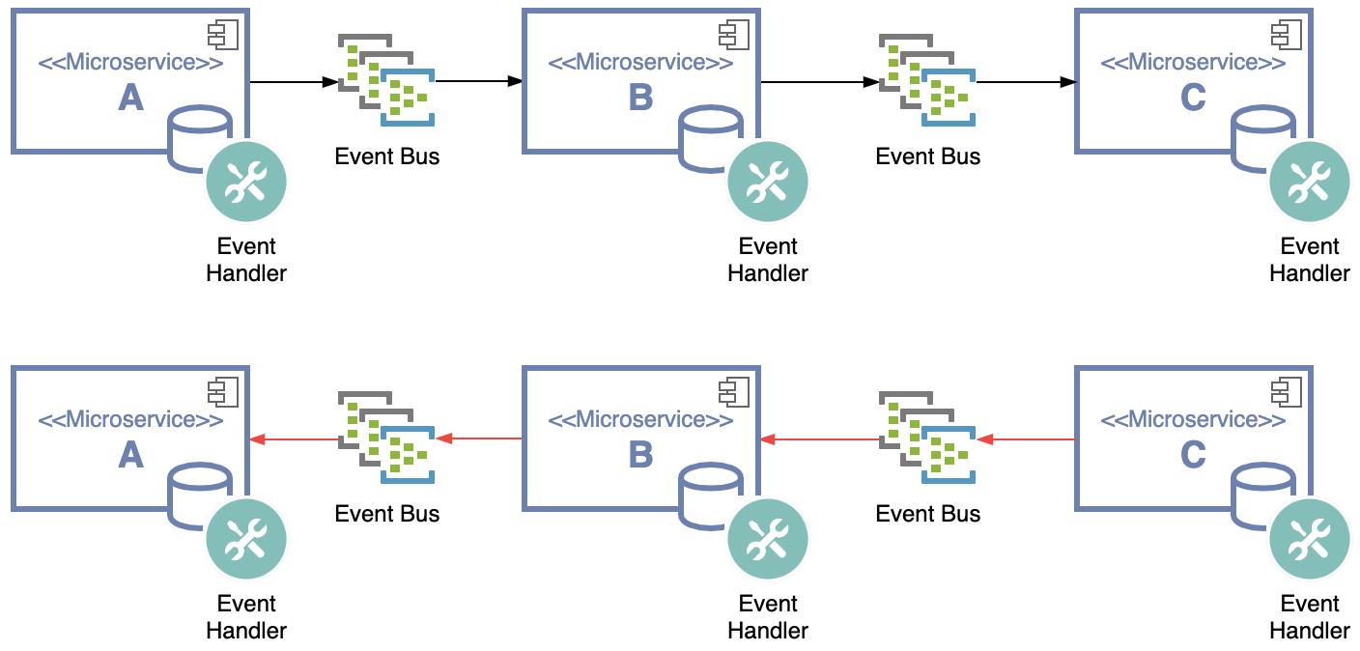
Microservices - Saga Pattern
We implement event handlers as stateless services.
Typical Event Handler:
Implements lightweight logic
Is stateless
Is triggered by an event

Slide 20
References:
Kubernetes Multitenancy: https://www.infoq.com/presentations/multi-tenancy-kubernetes/
Cluster multi-tenancy: https://cloud.google.com/kubernetes-engine/docs/concepts/multitenancy-overview
Project plan for multitenancy: https://docs.google.com/document/d/1U8RQQmTUjxgMZY05HG2f7b3KsB94BhK4Ko6aWbLNXcc/edit#
Priority and Fairness for API Server Requests: https://github.com/kubernetes/enhancements/blob/master/keps/sig-api-machinery/20190228-priority-and-fairness.md

